Slide 1
DS389: Final Project
Seth Robertson

Slide 2
Intro
100,000 total transactions over 2 years
Of these, 6,111 transactions (6.11%) are fraud
Recommend following 3 defenses:

Slide 3
Recommendation 1: High risk account info
Decline transactions with flagged Ip addresses, phone numbers, email addresses, or payee accounts*
Full_Name_Email = Crook@Gmail.com | vader@Empire.com
Customer_Phone = 786-222-4810
IP_Address = 101.101.911
Payee_Account = 111777 | 4523423
* Account info was flagged if multiple accounts were associated with the same phone number, email address, etc.

Slide 4
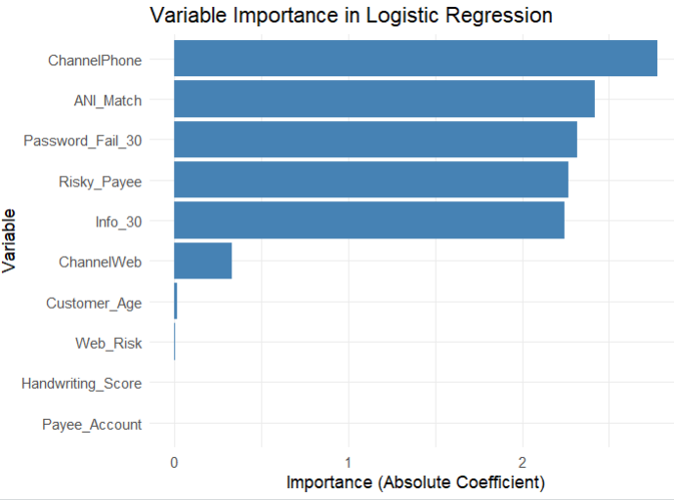
Recommendation 2: Implement Logistic Regression
Decline transactions with logistic regression score >= 350
Something here

Slide 5
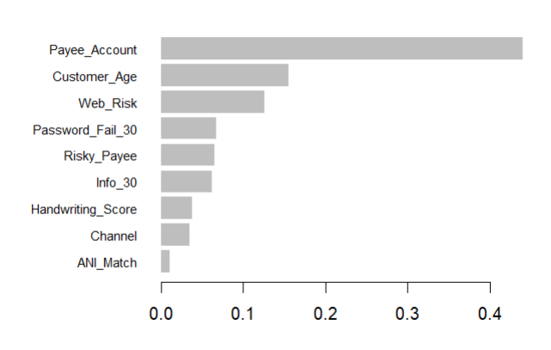
Recommendation 3: Implement Gradient Boosting
Decline transactions with Gradient Boosting score >= 250
Something

Slide 6
Summary:
X transactions were flagged as fraud
5,244 of these are projected to be fraud
hit rate of 60%
$53,553,071 saved
X amount of fraud may still get through

